Slide 1

Sales Performance Dashboard
Power BI Dashboard Design | Data Analyst Internship Task 4
POWER BI
SALES ANALYTICS

Slide 2

OBJECTIVE
Dashboard Goals
Sales Performance
Trend Tracking
Top Performers
Data-Driven Decisions
Analyze overall sales metrics and business health
Monitor sales patterns over time periods
Identify leading products and regions
Enable stakeholder insights through interactive visuals

Slide 3
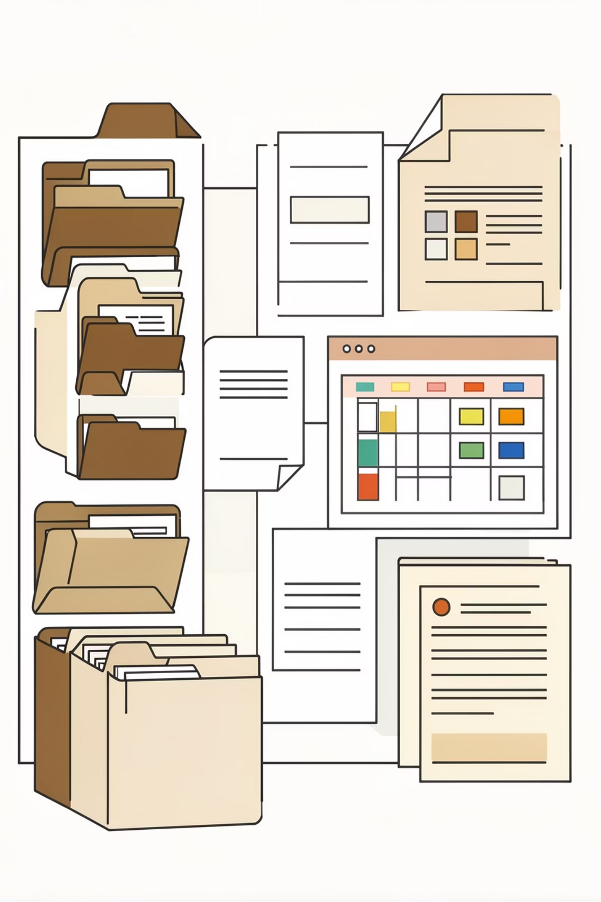
Dataset Overview
Sales Transaction Data
Comprehensive dataset including order details, product information, customer data, time-based attributes, and geographic information across multiple years.
1000+
7
50+
Orders
Categories
Countries
Multiple years
Product lines
Global reach

Slide 4
Key Data Fields
SALES
ORDERNUMBER
Revenue generated per transaction
Unique order identifier
ORDERDATE
PRODUCTLINE
Transaction date stamp
Product category classification
COUNTRY
TIME FIELDS
Geographic location data
Year, quarter, month analysis

Slide 5
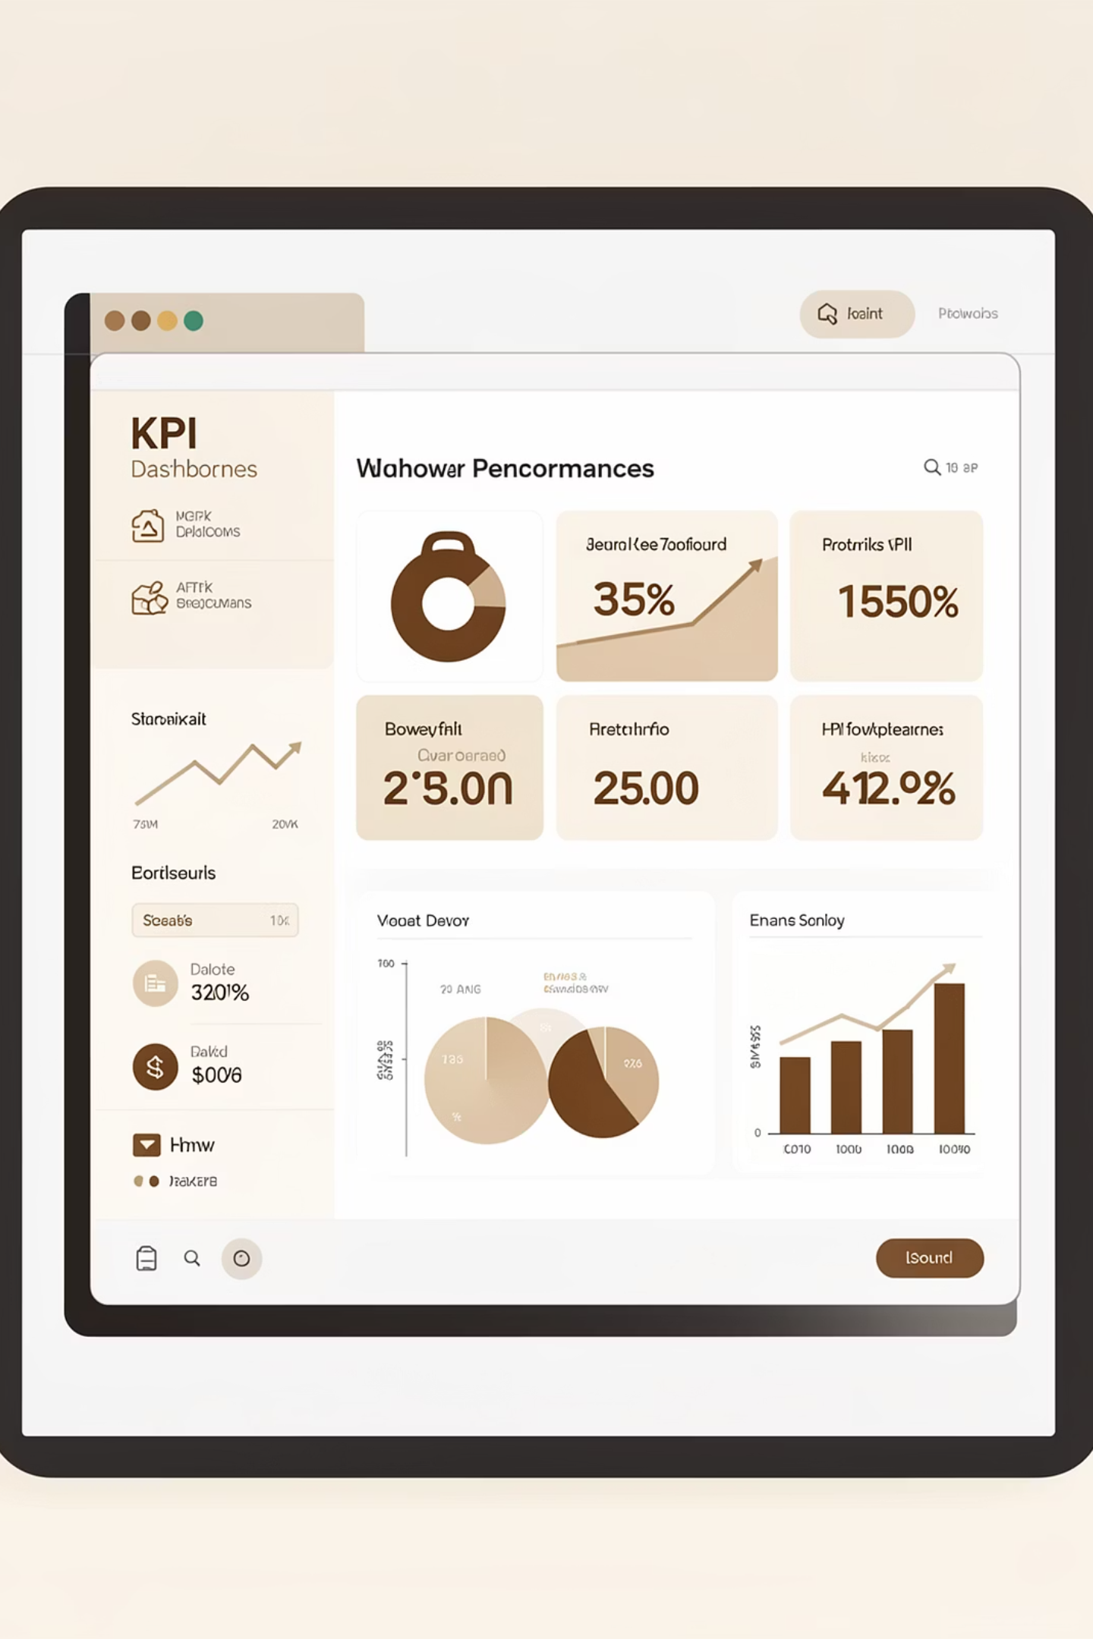
Key Performance Indicators
Total Sales
Overall revenue generated
Total Orders
Number of transactions
Quantity Sold
Total units moved
Average Order Value
Revenue per transaction
These KPIs provide a quick business summary at a glance for stakeholders.

Slide 6

Dashboard Visualizations
Donut Chart
Visual Components
Line Chart
The dashboard combines multiple chart types to tell a complete story:
KPI cards display summary metrics
Line charts show sales trends over time
Bar and column charts compare categories
Donut charts reveal distributions
Maps visualize geographic performance
KPI Cards
Bar Chart
Column Chart

Slide 7
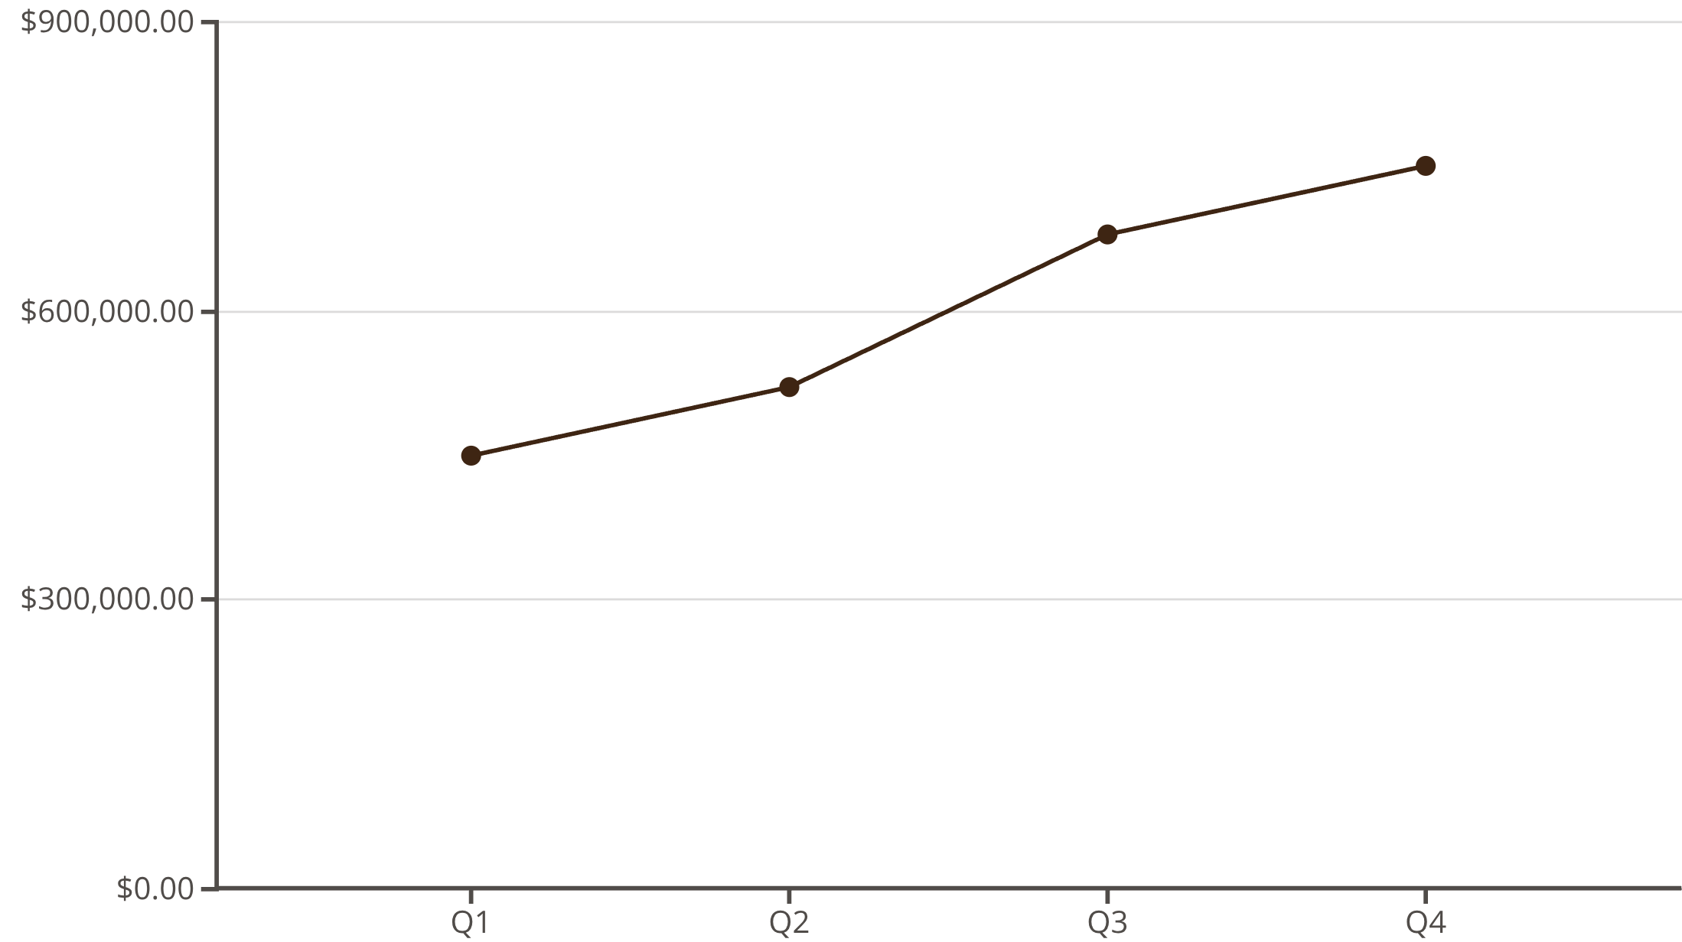
TREND ANALYSIS
Sales Growth Over Time
Time Series Insights
Line charts reveal sales growth patterns across months and years, helping identify seasonal trends and supporting strategic forecasting.
Monthly trends show peak periods
Yearly growth indicates expansion

Slide 8

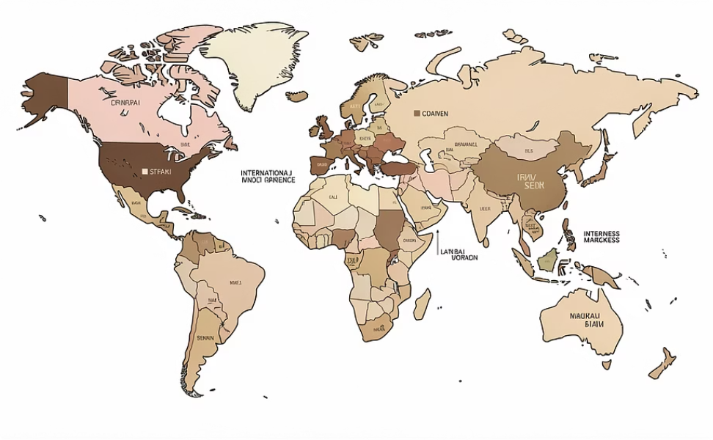
Product & Regional Performance
Product Line Analysis
Geographic Insights
Bar charts compare categories to identify best and worst performers, optimizing inventory and marketing strategy.
Sales analyzed by country and territory reveal high-revenue regions, guiding expansion and targeting decisions.

Slide 9
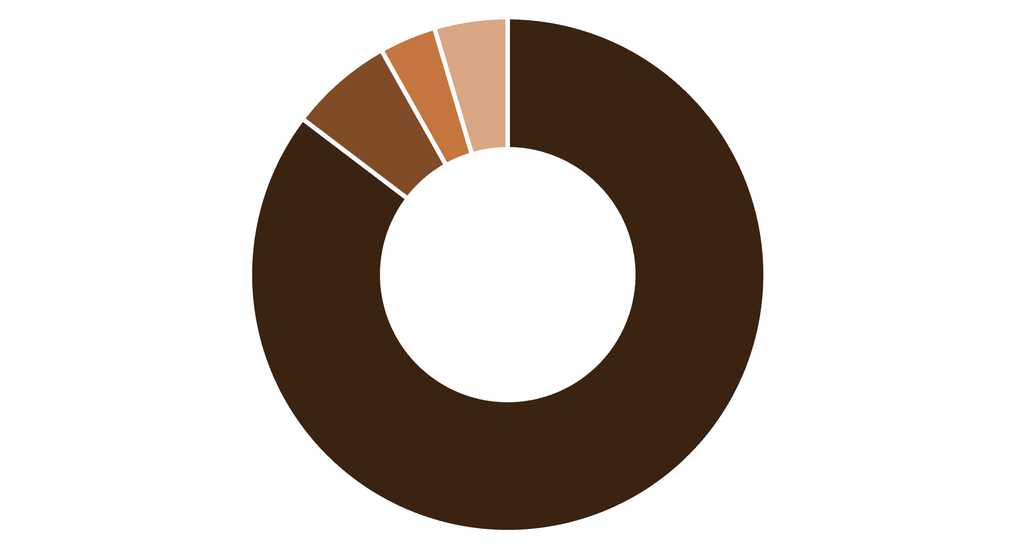

Order Status Distribution
Shipped
Pending
Cancelled
Processing
Operational Excellence
The majority of orders are successfully shipped, with only a small percentage cancelled or pending. This indicates strong operational performance and customer satisfaction.
90%
Success Rate

Slide 10

Dashboard Interactivity
Empowering users with dynamic controls for in-depth data exploration.
Slicers for Granular Control
Filter by Year to track historical performance
Analyze sales by Country for regional insights
Drill down into Product Line performance
Monitor operational flow by Order Status
Dynamic Visual Updates
All charts and KPIs automatically adjust to reflect the selected filters, providing real-time data views without needing to refresh.
User-Driven Analysis
Stakeholders can independently explore data points relevant to their specific questions, fostering deeper understanding and faster decision-making.

Slide 11

Key Insights & Conclusion
01
Consistent Growth
Sales show upward trend with seasonal peaks
02
Product Leaders
Certain lines drive majority of revenue
03
Regional Strength
USA and key territories dominate sales
04
Interactive Power
Dashboard enables data-driven decisions
This Power BI dashboard provides clear sales performance overview with interactive visuals supporting better decision-making and enhanced data analysis skills.

Slide 12
Thank You..

